Slide 1
Introduction to scRNA-seq and data preprocessing
Jeremy M. Simon, Ph.D.
Senior Research Scientist
Dana-Farber Cancer Institute | Department of Data Science
Harvard T.H. Chan School of Public Health | Department of Biostatistics
jsimon@ds.dfci.harvard.edu

Slide 2
Before we begin: download reference genome and GENCODE gene annotation for later use
# Download reference genome sequence (Takes ~20 min to download)
wget https://ftp.ebi.ac.uk/pub/databases/gencode/Gencode_human/release_45/GRCh38.primary_assembly.genome.fa.gz
# Download GENCODE GTF of gene annotations
wget https://ftp.ebi.ac.uk/pub/databases/gencode/Gencode_human/release_45/gencode.v45.annotation.gtf.gz
If “wget” doesn’t work (it may not come pre-installed on OS X), try “curl -O” in its place instead
Links also accessible on GENCODE website here:
https://www.gencodegenes.org/human/
Genome sequence, primary assembly (GRCh38): FASTA
Comprehensive gene annotation: GTF
Or similarly for mouse (not covered today):
https://www.gencodegenes.org/mouse/
Make sure you don’t mix and match releases!
Human v45 release is built on GRCh38/hg38
Earlier releases are needed if using hg19
More info here: https://www.gencodegenes.org/human/releases.html

Slide 3
Introduction to scRNA-seq and data preprocessing
Jeremy M. Simon, Ph.D.
Senior Research Scientist
Dana-Farber Cancer Institute | Department of Data Science
Harvard T.H. Chan School of Public Health | Department of Biostatistics
jsimon@ds.dfci.harvard.edu

Slide 4
Outline for workshop
Part I
Rationale: Why do single-cell RNA-seq?
Overview of experimental methodologies/platforms
Best practices for experimental design
Overview of data processing tools
Part II
Workshop: Pre-processing scRNA-seq data using alevin-fry
All slides, code, and recordings will be available afterwards. If you have issues with downloading, installing, or running any of the code here today, don’t panic!
We may not be able to get it resolved live but this should all be doable at-your-own-pace later

Slide 5
Part I
Introduction to scRNA-seq: theory, platforms, biological considerations, and best practices

Slide 6
Why single-cell RNA-seq?
Complex tissues contain lots of diverse cell types at different proportions
Profiling gene expression of tissue in bulk provides essentially a population-wide average, which can vary based on cellular composition
 | Green | Blue | Orange | Black | TISSUE
GeneA | 10 | 5 | 15 | 50 | 20
GeneB | 2 | 50 | 20 | 0 | 18
GeneC | 3 | 3 | 3 | 3 | 3
GeneD | 50 | 0 | 40 | 10 | 25
GeneE | 0 | 10 | 40 | 10 | 15

Slide 7
Why single-cell RNA-seq?
Condition 1
Condition 2
Scenario 1:
Altered proportions
In either scenario, bulk RNA-seq would likely have insufficient power to detect these differences
Condition 1
Condition 2
Scenario 2:
Altered expression
in subset of cells
Cell type A
Cell type B
Cell type C
Cell type D
Cell type D’

Slide 8
Why single-cell RNA-seq?
Condition 1
Condition 2
Scenario 1
Condition 2
Scenario 2
Bulk
Traditional
solution:
FACS-sorted
Green | 7
Blue | 7
Orange | 5
Black | 5
Green | 7
Blue | 7
Orange | 3*
Black | 8*
Green | 7
Blue | 7
Orange | 5
Black | 5

Slide 9
Why single-cell RNA-seq?
FACS sorting can detect proportional shifts in cell types, provided enough cells and strong selective markers
Sorting is unlikely to detect effects in subsets of cell types, and may still be underpowered even if followed by RNA-seq
For complex tissues, all of this is cost-prohibitive, and often the effect is unknown

Slide 10
Single-cell RNA-seq using 10X
Co-capture individual cells with barcoded beads
Typically 3’ based with oligo-dT amplification, but 5’ also an option
After sequencing, deconvolute which detected transcripts came from which cells
One “inlet” of 10X lane can only process ~10k cells, and by default only 1 experimental condition at a time
More on this later
https://mccarrolllab.org/dropseq/

Slide 11
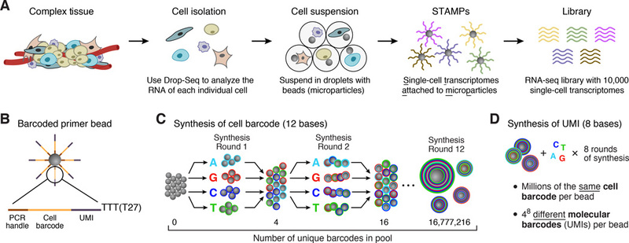
Single-cell RNA-seq via droplet microfluidics (10X, inDrop, Drop-seq)
Prepare tagged beads (this is done commercially)
Prepare single-cell solution (this is done by the lab)
Macosko et al, Cell, 2015

Slide 12
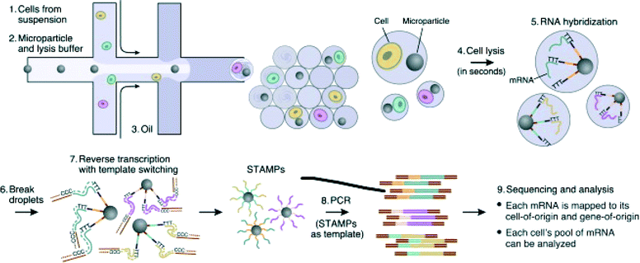
Single-cell RNA-seq via droplet microfluidics (10X, inDrop, Drop-seq)
Macosko et al, Cell, 2015

Slide 13
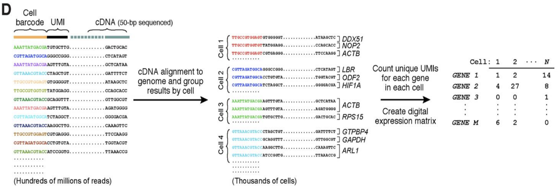
Deconvolution of barcodes determines which cells express which genes
Macosko et al, Cell, 2015

Slide 14
Brief overview of data processing
Deconvolute cell/molecular barcodes + error correction
Trim 5’ primer sequence
Trim 3’ polyA sequence
Alignment
Determine which reads came from which transcripts
Selection of “real” cells vs obvious debris/noise
Construct cells x genes data matrix
R2.fastq
R1.fastq
@K00270:34:HGWWGBBXX:1:1101:1641:1279 1:N:0:NGAGCTAC
TGAACGTAGGCGGGGAAGAG
+
AAAFFJJJJJJJJJJJJFJJ
@K00270:34:HGWWGBBXX:1:1101:1945:1279 1:N:0:NGAGCTAC
GGTACATGTAGTATACCTTT
+
AAFFFJJJJJJJJJJJJJJJ
@K00270:34:HGWWGBBXX:1:1101:29437:1894 2:N:0:GGAGCTAC
GAAGAATCCGAGGAGTCTGATGATGACATGGGCTTTGATCTATTTGAATA
+
A<<AAJ<A7FF<7-7-7-7F--JA-JAJ<-7-7-7----<------7--<
@K00270:34:HGWWGBBXX:1:1101:29680:1894 2:N:0:GAAGCTAC
ATGCTATTCATGTCTTTATACAACTAAAGCTGATCTGACTGAGCATGTCA
+
-<-7-77A<--<A----<<7FF<A-7F<-<A-FJAFAFA---F<A----<

Slide 15
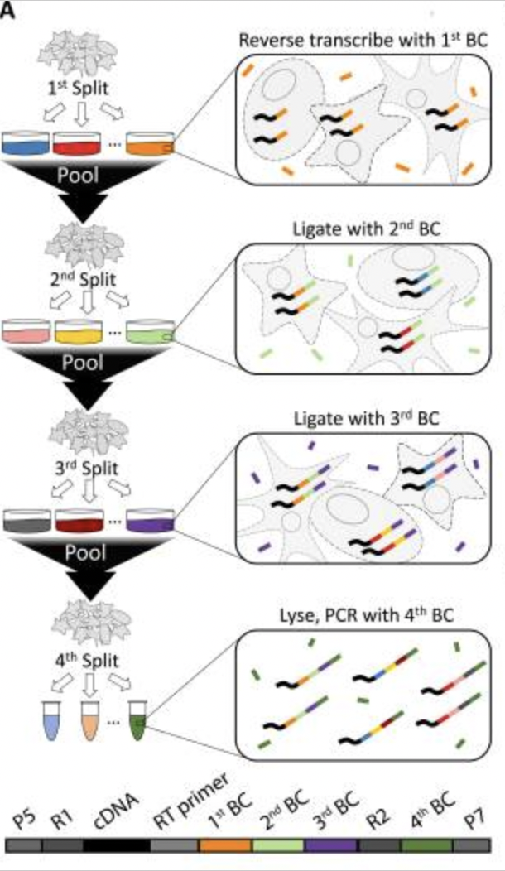
Single-cell RNA-seq using combinatorial indexing (e.g. SPLiT-seq, ParseBio)
First barcode is added via oligo-dT or random hexamer priming
2nd and 3rd barcodes are added sequentially after a pooling and splitting of cells
4th barcode is compatible with Illumina sample multiplexing
Each of these corresponds to one “sublibrary”, ie a unique collection of BC1-BC2-BC3 combinations
Watch movie here to understand better:
https://www.youtube.com/watch?v=WqaeZe7mKUc
Also see: sci-seq
Rosenberg, et al, Science, 2018

Slide 16
Benefits to combinatorial indexing strategies
Can process hundreds of thousands or even millions of cells simultaneously from multiple conditions
No special equipment needed (plate-based)
Transcripts amplified via oligo-dT and random hexamers
PolyA/3’ end plus sequences internal to transcript
Cheap per cell and scalable
Minimal batch effects given parallel sample processing
Compatible with both fresh and fixed cells or nuclei
See here for one solution for processing data of this type:
https://combine-lab.github.io/alevin-fry-tutorials/2022/split-seq/

Slide 17
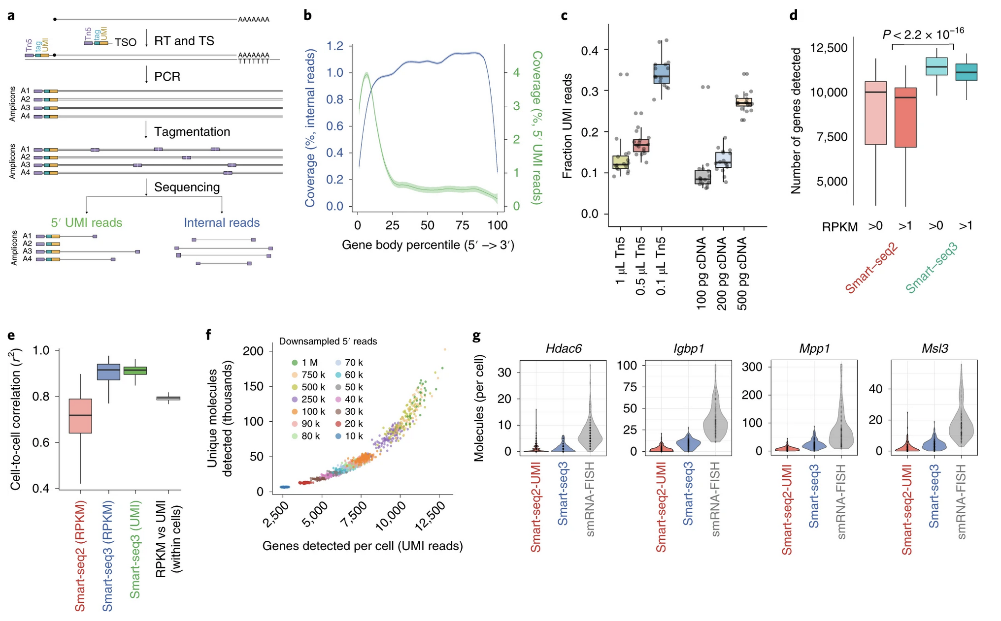
Single-cell RNA-seq with full-length transcripts using Smart-seq
https://doi.org/10.1038/s41587-020-0497-0

Slide 18
Single-cell multi-omics and/or spatial approaches
RNA + ATAC (chromatin accessibility)
RNA + cell surface protein expression (CITE-seq)
RNA + TCR
Protein-DNA interactions + cell surface protein expression (scCUT&Tag-Pro)
RNA + spatial
ATAC + spatial
…etc

Slide 19
Best practices for experimental design
Replicates, replicates, replicates!
Some (incorrectly) argue that since each cell is a replicate of the next, you don’t need true biological replicates
Best approach: multiple human tissue samples, multiple mice, multiple cell culture plates, etc per condition group
Variability in expression, and especially in cell proportions assigned to each cell type, is unfortunately quite large
I recommend labs do >3 replicates/samples per condition to capture and account for this variability
Each replicate should have several thousand cells sequenced targeting >50k reads/cell, I recommend >10k cells per condition
Atlas-scale studies usually require far more cells to capture the diverse cellular landscape

Slide 20
Best practices for experimental design
Control for batch effects!
10X can only isolate one sample at a time by default
Often the only option for patient-derived samples
This means separate isolations for different experimental conditions- a major confounder in doing any statistics, and one that can’t be explicitly corrected
Newer “Cell Hashing” (hashtag oligo, HTO) approaches allow for multiplexing, but may not work for certain cell types as it is antibody/lipid mediated, and costs extra
Encourage collaborators to at least obtain e.g. WT_rep1 and MUT_rep1 on the same day if multiplexing is not possible
Other non-10X solutions (e.g. SPLiT-seq/ParseBio) may be more appropriate for complex experimental setups with multiple conditions, for tissues where Cell Hashing is less effective, or for cases when many (>100k) cells are needed

Slide 21
Other considerations
Unknown whether cell size plays a role in isolation. Do larger cells get stuck in microfluidics channels and not get discovered? You only get what you get…
Data are very sparse, lots of 0s. Essentially probing expression of only top 10-20% expressed genes
If lab is interested in genes known to be lowly expressed (many transcription factors are!), droplet-based scRNA-seq may not be appropriate
Can sequence whole cells or just nuclei
This is especially relevant for cell type annotation, nuclear vs cytoplasmic expression patterns can be very different!
5’ vs 3’ chemistry
Which end of the transcript is sequenced?
Data processing is different depending on this!
Only 5’ is compatible with VDJ workflow for TCR repertoire analysis

Slide 22
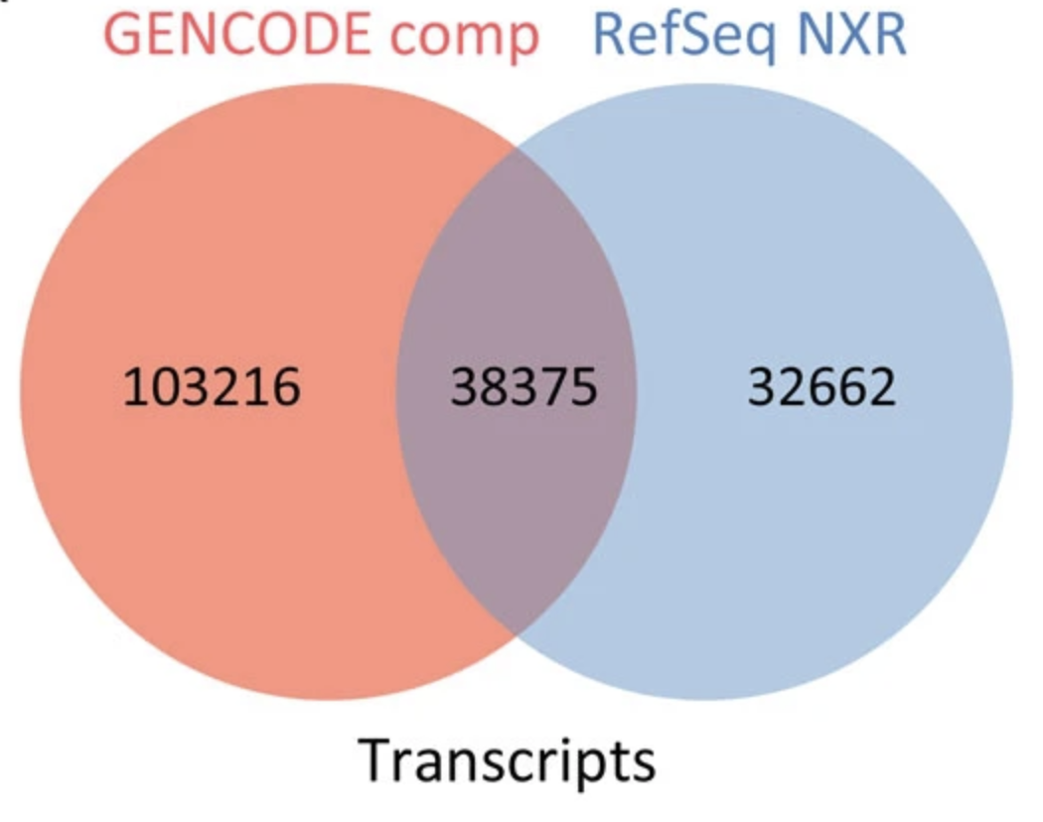
YOAGAYA :: You’re Only As Good As Your Annotations
Use an appropriate, updated, and most importantly CONSTANT reference genome and gene annotations for all samples for a given study
UCSC/RefSeq vs GENCODE/Ensembl
GENCODE is more comprehensive, therefore gives the best chance for a read to align and be counted appropriately
GENCODE updated ~2-3x per year
Spliced, unspliced, ambiguous counts
Spliced: reads that map to splice junctions
Unspliced: reads that map to introns
Ambiguous: reads that map entirely in an exon
Advantageous to include Unspliced reads, and is now default in CellRanger >= v7
Genome vs Transcriptome vs Splici annotation governs how these reads are counted and allocated
Frankish et al, BMC Genomics, 2015
https://doi.org/10.1371/journal.pcbi.1008585
https://combine-lab.github.io/alevin-fry-tutorials/2021/improving-txome-specificity/ https://www.10xgenomics.com/support/software/cell-ranger/latest/miscellaneous/cr-intron-mode-rec
https://pyroe.readthedocs.io/en/latest/building_splici_index.html#preparing-a-spliced-intronic-transcriptome-reference

Slide 23
alevin-fry: Open-source alternative to CellRanger
My preference for single-cell data processing
Written and supported by Rob Patro’s lab
Same group that wrote Salmon for bulk RNA-seq transcript quantification
alevin is within the salmon ecosystem
Flexible regarding read/barcode geometries, even custom
Therefore can easily handle data from 10X, SPLiT-seq/ParseBio, and others
Can also process spatial transcriptomic data (e.g. 10X Visium)
Can process hashed/multiplexed samples (HTO), CITE-seq, etc
Tons of helpful tutorials/vignettes, active and responsive github community
Deployable and scalable with helpful wrappers
simpleaf (https://github.com/COMBINE-lab/simpleaf)
Nextflow (https://github.com/COMBINE-lab/quantaf)
nf-core scrnaseq (https://nf-co.re/scrnaseq)
https://alevin-fry.readthedocs.io/en/latest/
https://combine-lab.github.io/alevin-fry-tutorials/#blog
https://github.com/COMBINE-lab/salmon/

Slide 24
Part II
Introduction to scRNA-seq data pre-processing with alevin-fry

Slide 25
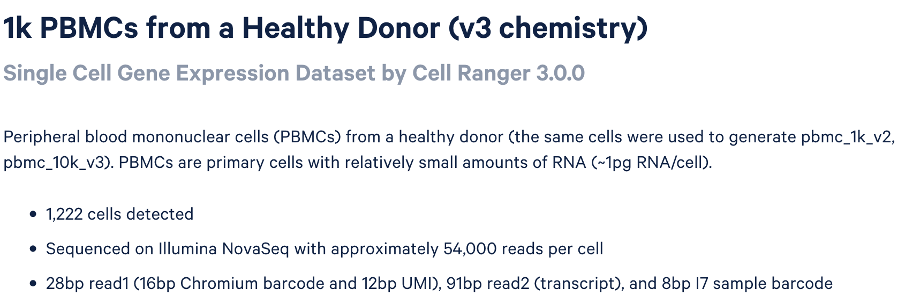
Example data: 1k PBMC 10X, 3’, v3 chemistry
Notes:
V2 chemistry is similar, except it has 16bp barcode + 10bp UMI
5’ libraries utilize V2 chemistry
https://www.10xgenomics.com/datasets/1-k-pbm-cs-from-a-healthy-donor-v-3-chemistry-3-standard-3-0-0

Slide 26
Software required
pyroe
https://pyroe.readthedocs.io/en/latest/index.html
https://github.com/COMBINE-lab/pyroe
salmon
https://salmon.readthedocs.io/en/latest/building.html#installation
https://github.com/COMBINE-lab/salmon
DS/Kraken: module load salmon/1.10.0
alevin-fry
https://alevin-fry.readthedocs.io/en/latest/index.html
https://github.com/COMBINE-lab/alevin-fry
DS/Kraken: module load alevin-fry

Slide 27
Download example data (FASTQ format)
# Make working directory for workshop
mkdir DS_scRNA_20240228
# Download 10x FASTQ files
wget https://cf.10xgenomics.com/samples/cell-exp/3.0.0/pbmc_1k_v3/pbmc_1k_v3_fastqs.tar
# Un-tar FASTQ files
tar -xvf pbmc_1k_v3_fastqs.tar
# Peek at one of the R1 files
zcat pbmc_1k_v3_fastqs/pbmc_1k_v3_S1_L001_R1_001.fastq.gz | head -n 24
# Peek at one of the R2 files
zcat pbmc_1k_v3_fastqs/pbmc_1k_v3_S1_L001_R2_001.fastq.gz | head -n 24
If “wget” doesn’t work (it may not come pre-installed on OS X), try “curl -O” in its place instead
Note: There are 2 lanes (L001, L002) of sequencing. In this case, these files can be concatenated, either explicitly by us (cat) or implicitly during our first processing step (*R1*.gz, *R2*.gz)

Slide 28
Download reference genome and GENCODE gene annotation
# Download reference genome sequence (Takes ~20 min to download)
wget https://ftp.ebi.ac.uk/pub/databases/gencode/Gencode_human/release_45/GRCh38.primary_assembly.genome.fa.gz
# Download GENCODE GTF of gene annotations
wget https://ftp.ebi.ac.uk/pub/databases/gencode/Gencode_human/release_45/gencode.v45.annotation.gtf.gz
# Unzip both files
gunzip GRCh38.primary_assembly.genome.fa.gz
gunzip gencode.v45.annotation.gtf.gz
Links accessible on GENCODE website here:
https://www.gencodegenes.org/human/
Or similarly for mouse:
https://www.gencodegenes.org/mouse/
Make sure you don’t mix and match releases!
Human v45 release is built on GRCh38/hg38
Earlier releases are needed if using hg19
More info here: https://www.gencodegenes.org/human/releases.html

Slide 29
Generate splici annotation
Install package pyroe
With pip:
pip install pyroe --user
Or alternatively with conda:
conda install pyroe -c bioconda
Run pyroe (Takes ~8min to run)
pyroe make-spliced+intronic \
GRCh38.primary_assembly.genome.fa \
gencode.v45.annotation.gtf \
90 \
gencode.v45.annotation_splici_fl85

Slide 30
Index splici annotation for salmon alevin
Install pre-compiled binary of salmon (if needed)
wget https://github.com/COMBINE-lab/salmon/releases/download/v1.10.0/salmon-1.10.0_linux_x86_64.tar.gz
tar –xzvf salmon-1.10.0_linux_x86_64.tar.gz
If using DS servers:
module load salmon/1.10.0
Other cases, follow steps outlined here:
https://salmon.readthedocs.io/en/latest/building.html#installation
Then create salmon index of our splici reference (Takes ~20min to run)
salmon index \
-t gencode.v45.annotation_splici_fl85.fa \
--gencode \
-i gencode.v45.annotation_splici_fl85_idx \
-p 8

Slide 31
Processing step 1: alevin Barcode/UMI extraction, mapping of sequencing reads
Note on 10X chemistries:
V3 chemistry
--chromiumV3
OR manually specify via
--bc-geometry 1[1-16]
--umi-geometry 1[17-28]
--read-geometry 2[1-end]
V2 chemistry (including 5’ libraries) --chromium
OR manually specify via
--bc-geometry 1[1-16]
--umi-geometry 1[17-26]
--read-geometry 2[1-end]
General execution:
salmon alevin \
-l ISR \
--dumpFeatures \
-i gencode.v45.annotation_splici_fl85_idx \
-1 pbmc_1k_v3_fastqs/*R1*.fastq.gz \
-2 pbmc_1k_v3_fastqs/*R2*.fastq.gz \
--chromiumV3 \
-o 1k_PBMC_alevin_out \
-p 4 \
--sketch \ --rad
Including ”--sketch --rad” here so we perform a fast sketch-based alignment and report the reads in a RAD (binary) format for use with alevin-fry
Optional: include --dumpFeatures for downstream use of AlevinQC
Note: Step 1 could utilize piscem instead:
https://github.com/COMBINE-lab/piscem

Slide 32
Install alevin-fry, if needed
Install rustup, source cargo environment
curl --proto '=https' --tlsv1.2 -sSf https://sh.rustup.rs | sh
source "$HOME/.cargo/env"
Retrieve alevin-fry source directory
wget https://github.com/COMBINE-lab/alevin-fry/archive/refs/tags/v0.8.2.tar.gz
Unzip tarball
tar -xzvf v0.8.2.tar.gz
cd into alevin-fry directory
cd alevin-fry-0.8.2
Build alevin-fry
cargo build --release
Test
target/release/alevin-fry -h
Optional: add directory to $PATH
export PATH=`pwd`/target/release/:$PATH

Slide 33
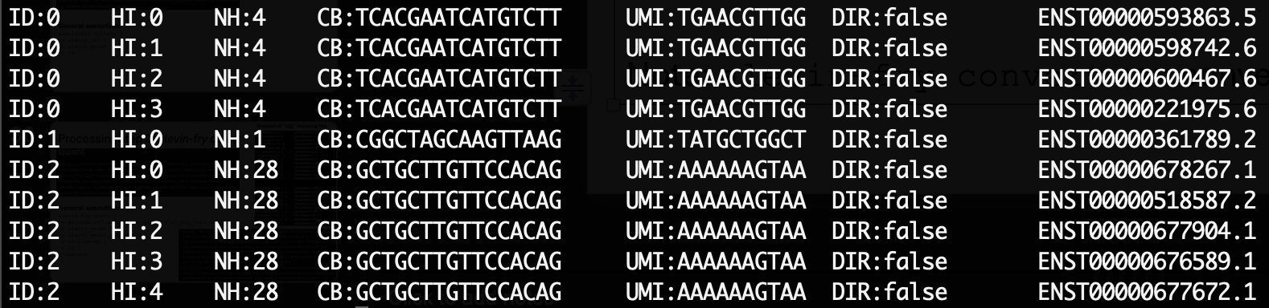
What’s in a RAD file?
alevin-fry view -r 1k_PBMC_alevin_out/map.rad | head
Note: alevin-fry convert can convert BAM to RAD format if desired

Slide 34
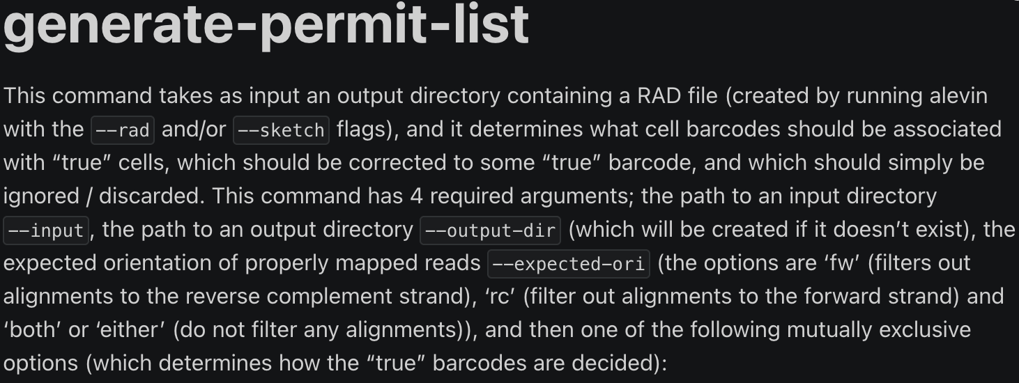
Processing step 2: alevin-fry generate-permit-list
General execution:
alevin-fry generate-permit-list \
-d fw \
-k \
-i 1k_PBMC_alevin_out \
-o 1k_PBMC_alevin_quant
Note on 10X chemistries:
3’ libraries must utilize
-d fw
5’ libraries must utilize
-d rc
Optional: include --expect-cells 8000 or some other value based on known loading of 10X instrument

Slide 35
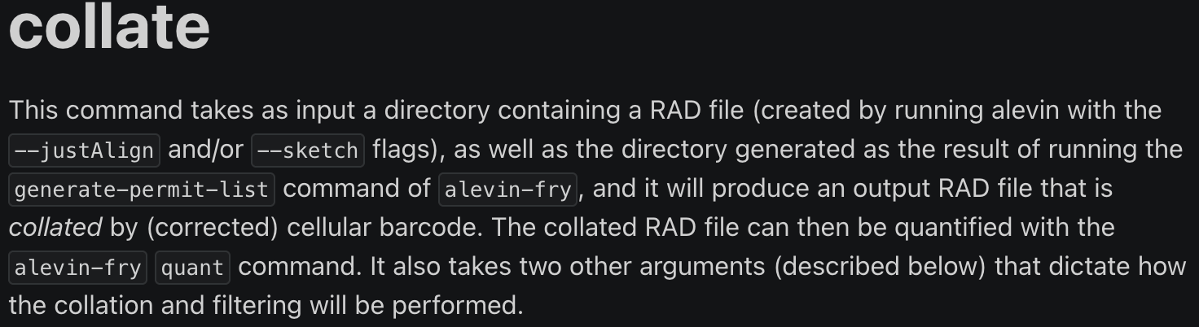
Processing step 3: alevin-fry collate
General execution:
alevin-fry collate \
-r 1k_PBMC_alevin_out \
-i 1k_PBMC_alevin_quant \
-t 16

Slide 36
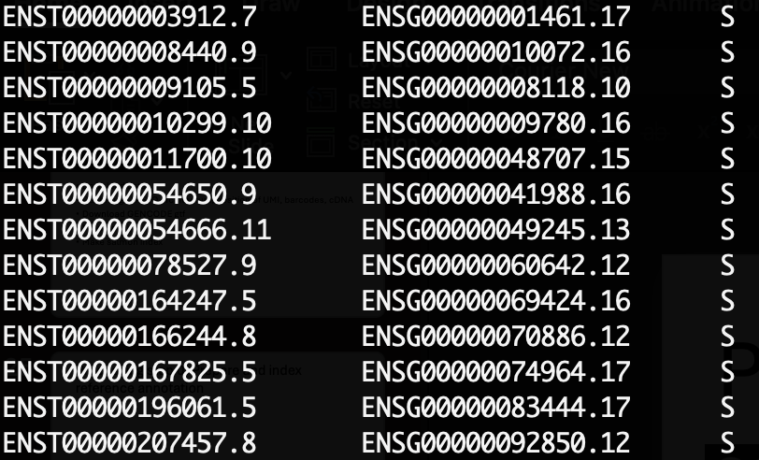
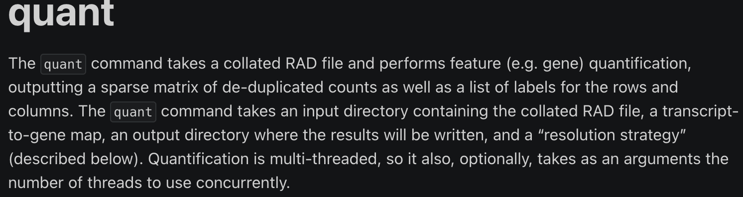
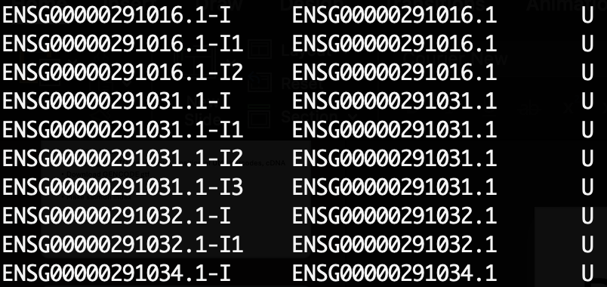
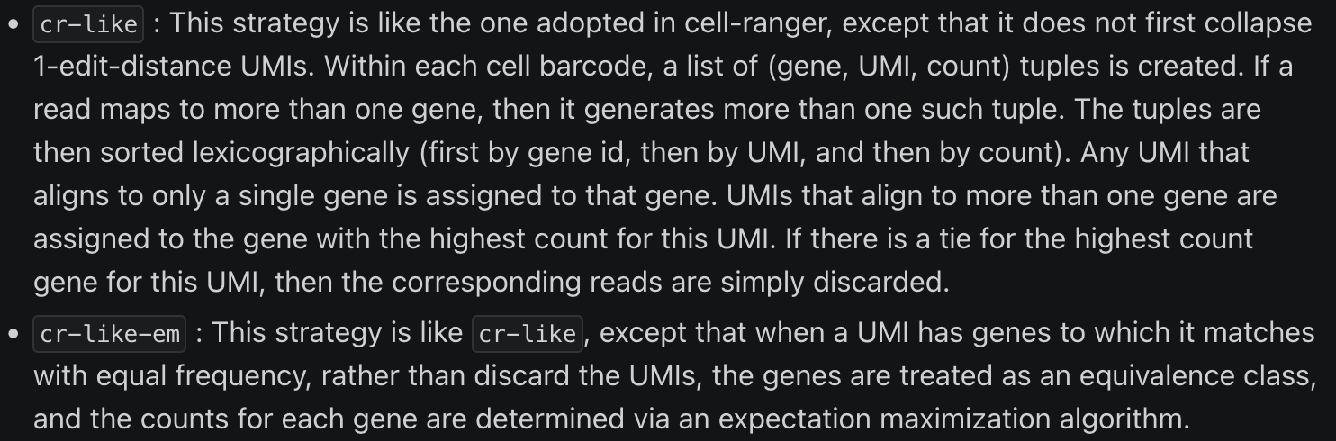
Processing step 4: alevin-fry quant
Snippet of “t2g” mapping file
[…]
General execution:
alevin-fry quant \
-m gencode.v45.annotation_splici_fl85/splici_fl85_t2g_3col.tsv \
-i 1k_PBMC_alevin_quant \
-o 1k_PBMC_alevin_quant_crlikeem \
-r cr-like-em \
-t 16 \
--use-mtx

Slide 37
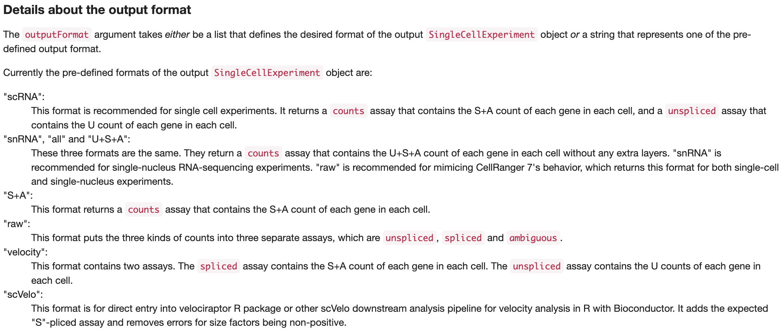
How to import alevin-fry output into R with fishpond::loadFry()
BiocManager::install("fishpond")
library(fishpond)
Sample1_RNA <- loadFry("1k_PBMC_alevin_quant_crlikeem",
outputFormat = "snRNA")

Slide 38
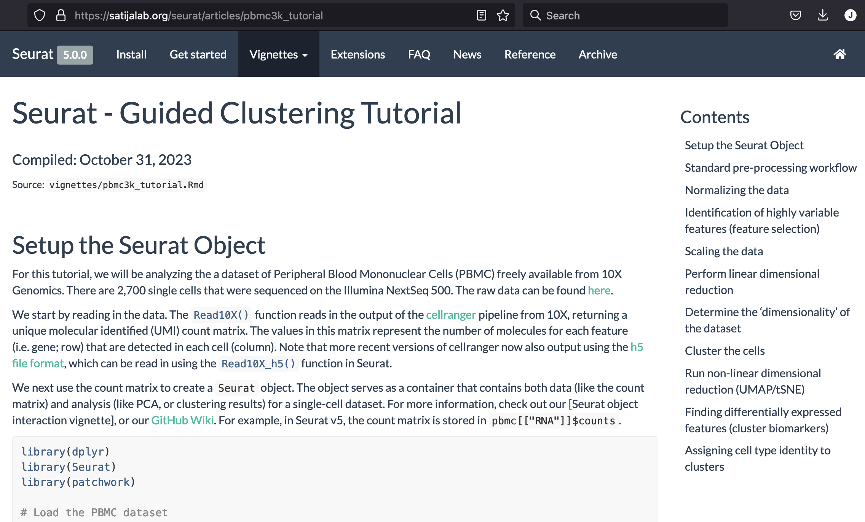
Follow basic Seurat analysis workflow
https://satijalab.org/seurat/articles/pbmc3k_tutorial

Slide 39
Full code and details available on GitHub
https://github.com/jeremymsimon/DS_scRNA_20240228

